Slide 1
An Introduction to the C++ Network Library
Glyn Matthews
Belgian C++ User Group

Slide 2
Introduction Network Programming in C++ C++ Network library (0.9.4) C++1y The Future

Slide 3
About me
Glyn Matthews
Software Engineer and ScrumMaster at SoftKinetic, Brussels
Developer and Project Administrator C++ Network Library
http://glynos.github.com/
@glynos

Slide 4



Slide 5
What is the C++ Network Library?
A collection of libraries for HTTP and application-level protocols
Network types (URI)
Hosted on Github:
http://cpp-netlib.github.com/

Slide 6
Hello, world! (HTTP Client)
using namespace boost::network;
using namespace boost::network::http;
int main(int arg, char *argv[]) {
client::request req("http://127.0.0.1:8000/");
req << header("Connection", "close");
client c;
client::response res = c.get(req);
std::string b = body(res);
}

Slide 7
Hello, world! (HTTP Server)
namespace http = boost::network::http;
struct handler;
typedef http::server<handler> http_server;
struct handler {
void operator() (http_server::request const &req,
http_server::response &res) {
res = http_server::response::stock_reply(
http_server::response::ok,
"Hello, world!");
}
};

Slide 8
Hello, world! (HTTP Server)
int main(int arg, char *argv[]) {
handler h;
http_server s("0.0.0.0", "8000", h);
s.run();
return 0;
}

Slide 9
History
Started in 2007 by Dean Michael Berris
Header-only HTTP Client
Later developed a header-only HTTP Server
Added a URI class
Notes:
Started with a message template and HTTP client
Move to Github in 2009 brought a new impetus

Slide 10
Objectives
To develop a high quality, easy-to-use C++ networking library
To enable developers to extend the library
To lower the barrier of entry for cross-platform, network-aware C++ applications

Slide 11
Introduction Network Programming in C++ C++ Network library (0.9.4) C++1y The Future

Slide 12
Network libraries in C++
POCO http://pocoproject.org/
Qt http://qt-project.org/
libcurl http://curl.haxx.se/libcurl/
pion http://github.com/cloudmeter/pion

Slide 13
Boost.Asio
Low level I/O programming
Portable socket implements
TCP, UDP, ICMP

Slide 14
Boost.Asio
C++ Network Library is built on top of Boost.Asio

Slide 15
Introduction Network Programming in C++ C++ Network library (0.9.4) C++1y The Future

Slide 16
Twitter API Example
uri::uri
url("http://search.twitter.com/search.json");
uri::builder builder(url);
builder.query("q", uri::encode(argv[1]));
http::client c;
http::client::request req(url);
http::client::response res = client.get(req);

Slide 17
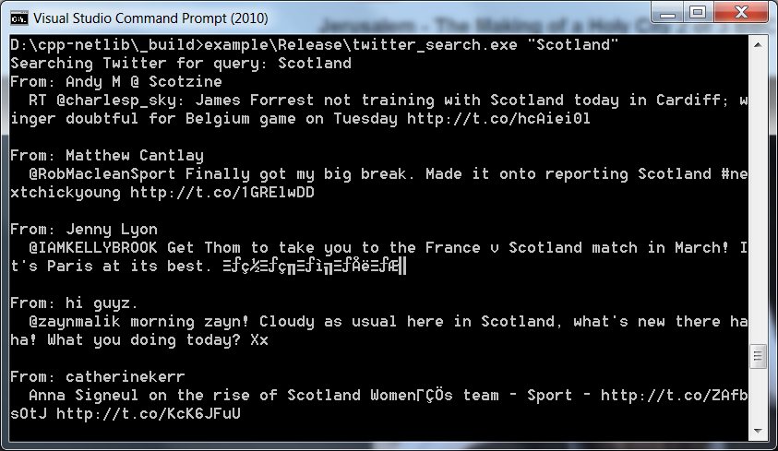
Console output of twitter_search example

Slide 18
RSS Feed Example
using namespace boost::network;
http::client client;
http::client::request req(argv[1]);
request << header("Connection", "close");
http::client::response res = client.get(req);

Slide 19
RSS Feed Example
rss::channel chan(response);
std::cout << "Channel: " << chan.title()
<< " (" << chan.description() << ")"
<< std::endl;
for (rss::item const &item; chan) {
std::cout << item.title()
<< " (" << item.author() << ")"
<< std::endl;
}

Slide 20
RSS Feed Example
using namespace boost::network;
class channel {
public:
channel(http::client::response const &res) {
std::string response_body = body(response);
rapidxml::xml_document<> doc;
doc.parse<0>(const_cast<char *>(
response_body.c_str()));
};

Slide 21
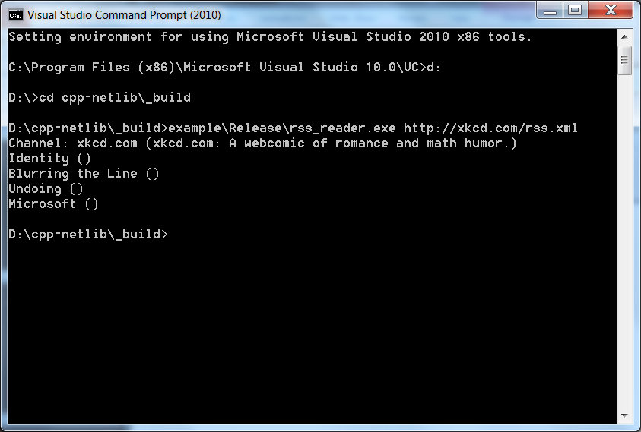
Console output of RSS Feed example

Slide 22
Issues with 0.9.4
Configuration options are limited in HTTP client
Lack of timeout support in HTTP client
Lack of asynchronous API in HTTP client
boost namespace (we’re not a part of boost)

Slide 23
Issues with 0.9.4
Still too large a burden on users for HTTP server implementation
Lack of session support in HTTP server
…

Slide 24
Boost
Potential long review and post-review process
SVN and integration process
Missing support for useful auxiliary libraries (XML, JSON, crypto)
Issues with licenses for auxiliary dependencies
Notes:
Our original intent was to prepare a submission

Slide 25
C++11
Useful features:
Type inference (auto)
String literals and multi-byte strings
Move semantics
Regular expressions

Slide 26
C++11
Useful features:
Extended iterator support (std::begin, std::end)
Concurrency support

Slide 27
Introduction Network Programming in C++ C++ Network Library (0.9.4) C++1y The Future

Slide 28
C++1y and SG4
The process for the next round of standardization is already under way
A study group (SG4) was created with the goal to standardize a set of network libraries
The target is 2017

Slide 29
SG4
The standardization effort will initially focus on basic socket layer functionality:
IP v4 / IP v6 Addresses
TCP/UDP sockets
URI
SSL Interface

Slide 30
C++1y URI Proposal
The network::uri class forms the basis of a proposal to the C++ standard library
network::uri will track the proposal as it evolves.

Slide 31
C++ standard SG4
http://www.open-std.org/jtc1/sc22/wg21/docs/papers/2012/n3420.html

Slide 32
URI
#include <network/uri>
class std::network::uri;
class std::network::uri::builder;

Slide 33
URI
std::network::uri
uri("http://www.becpp.org/blog/");
std::cout << uri.scheme() << std::endl
<< uri.host() << std::endl
<< uri.path() << std::endl;

Slide 34
URI
Output:
http
www.becpp.org
/blog/

Slide 35
URI Builder
std::network::uri uri;
std::network::uri::builder builder(uri);
builder.scheme("http")
.host(“www.becpp.org")
.path("/");
assert("http://www.becpp.org/" == uri);

Slide 36
Introduction Network Programming in C++ C++ Network Library (0.9.4) C++1y The Future

Slide 37
Vision
Abandon submission to Boost
Focus on C++1y
Develop application-level protocols

Slide 38
New HTTP Client API
struct client { enum class method
{ GET, PUT, POST, DELETE, OPTIONS }; client(client_options); };

Slide 39
New HTTP Client API
struct client { std::future<response> get(request,
request_options); std::future<response> put(request,
request_options); std::future<response> post(request,
request_options); std::future<response> delete_(request,
request_options); };

Slide 40
New HTTP Server API
template <
class Handler, class SessionManager, class Authenticator, class ConnectionManager> struct basic_server; typedef basic_server<> server;

Slide 41
Extending C++ Network Library
Logging
HTTP Web Services
SNMP
(E)SMTP
FTP
XMPP

Slide 42
Request for Volunteers
We need:
Protocol implementations
Users
Applications and examples

Slide 43
Request for Volunteers
We need:
Testers
Documentation

Slide 44
Thank You!
glyn.matthews@gmail.com
http://github.com/cpp-netlib/

